Slide 1



Mobile Phone Price Prediction
In this project, we'll develop a machine learning model to accurately predict mobile phone prices based on key features and specifications. Our analysis will provide valuable insights to inform pricing strategies and marketing decisions.
By Vicky Saini

Slide 2
Splitting the Dataset
Training Set
Testing Set
Validation
We'll use 80% of the dataset to train our machine learning model, allowing it to learn the relationships between phone features and prices.
The remaining 20% of the data will be held back as the testing set, to evaluate the model's performance on new, unseen data.
This split ensures we can properly validate the model's generalization capabilities before deployment.

Slide 3
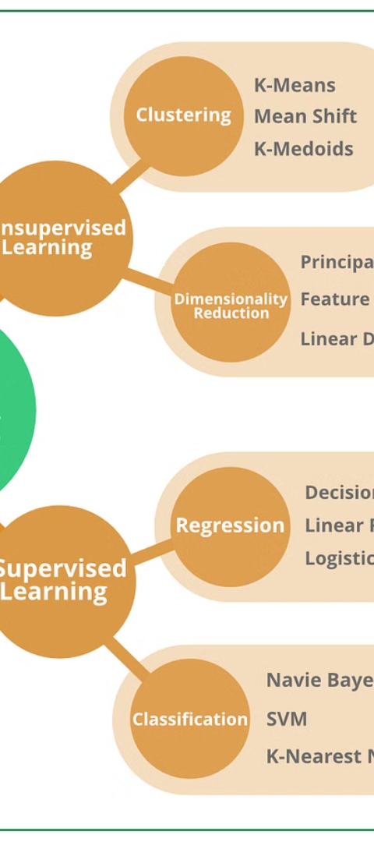
Developing the Prediction Model
1
Linear Regression
We'll start with a simple linear regression model to establish a baseline for price prediction.
2
Decision Trees
Next, we'll try a decision tree regressor, which can capture non-linear relationships in the data.
3
Advanced Models
Finally, we'll explore more sophisticated algorithms like random forests and gradient boosting to further improve prediction accuracy.

Slide 4
Evaluating Model Performance
1
Mean Absolute Error (MAE)
2
Root Mean Squared Error (RMSE)
This metric will tell us the average absolute difference between predicted and actual prices.
RMSE will give us a sense of the overall magnitude of prediction errors.
3
R-squared (R²)
4
Comparative Analysis
The R-squared value will indicate how well the model explains the variation in the target variable.
We'll compare the performance of each model to determine the most accurate predictor of mobile phone prices.

Slide 5
Feature Importance Analysis
Identify Key Drivers
Validate Assumptions
We'll analyze the feature importances to understand which phone specifications have the greatest impact on pricing.
This will allow us to confirm the significance of the features identified during the exploratory phase.
Inform Strategies
Continuous Improvement
The insights gained can guide pricing, product development, and marketing decisions for the organization.
Regular feature importance analysis can help the company stay agile and responsive to changing market demands.

Slide 6
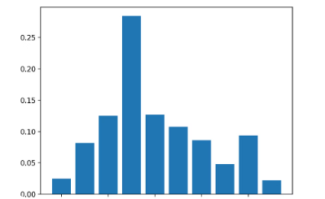
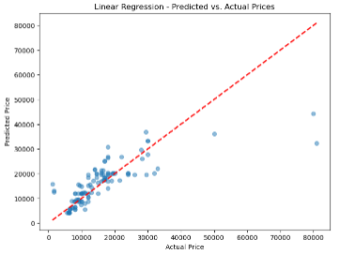
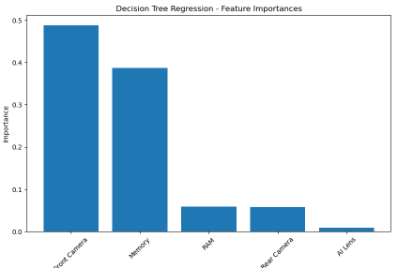
Visualizing Insights
Feature Importance Ranking
Price Prediction Accuracy
A visual representation of the model's feature importance scores will highlight the key drivers of mobile phone prices.
Scatter plots can demonstrate how well the model's predictions align with the actual observed prices.

Slide 7




Recommendations
Prioritize Features
Optimize Pricing
Adapt to Market
Focus development and marketing efforts on the most influential phone specifications identified by the feature importance analysis.
Use the price prediction model to set competitive and profitable prices that align with customer demand.
Continuously monitor feature importance and price trends to ensure the company remains responsive to changing market conditions.

Slide 8

Conclusion
By developing an accurate machine learning model for mobile phone price prediction, we've gained valuable insights to guide the organization's pricing, product, and marketing strategies. These insights will help the company stay competitive and adaptable in the dynamic mobile phone market.

